Slide 1

Alternate graphic representation 880 field in Alma
Yoel Kortick | Senior Librarian

Slide 2
Agenda
  Introduction
  An invisible 880 exists in the record
  Adding an 880 to a bibliographic record in the Metadata Editor
  Adding an 880 to a bibliographic record during import
2

Slide 3
Introduction

Slide 4
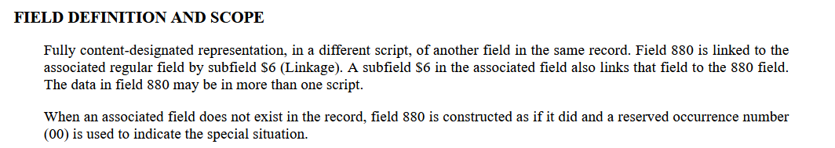
Introduction
The 880 field in MARC is the "Alternate Graphic Representation".
The field 880 is defined as follows at http://www.loc.gov/marc/bibliographic/bd880.html.

Slide 5
Introduction
For example, in title "Compendium of medicinal plants used by the indigenous people of Taiwan" (which we will soon see) there are sets of
  "245 and 880"
  "440 and 880"
  "710 and 880"
Each set of fields is connected with a subfield 6 which "points to" the other field which is the same field in a different script.

Slide 6
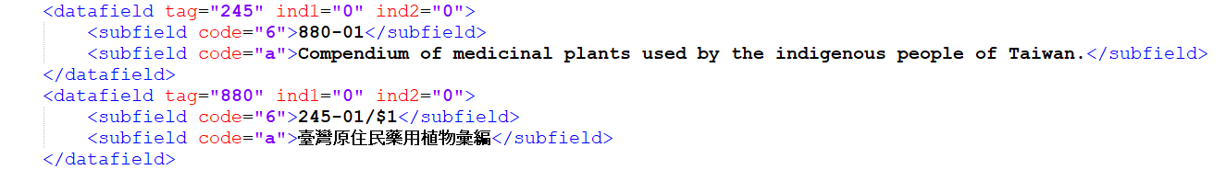
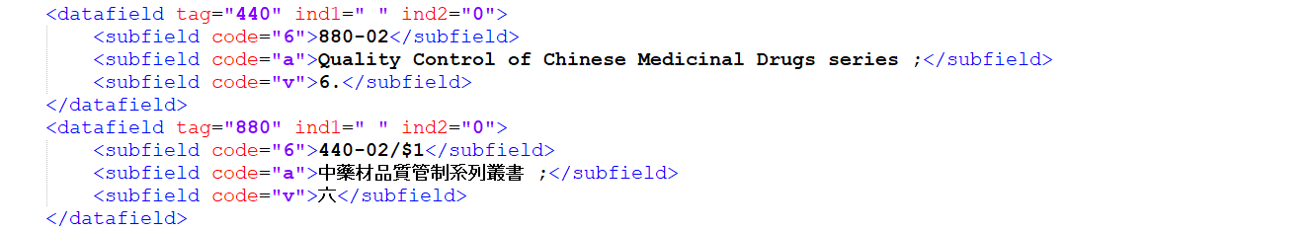
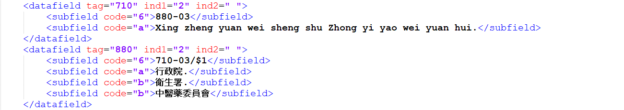
Introduction
Each set of fields is connected with a subfield 6 which "points to" the other field which is the same field in a different script.
6

Slide 7
An invisible 880 exists in the record

Slide 8
An invisible 880 exists in the record
On the next slide, which shows the bibliographic record for title "Compendium of medicinal plants used by the indigenous people of Taiwan" in the repository search results
  We do see the 245, 440 and 710 in the original and in the Alternate Graphic Representation,
  We do not see the 880 field.

Slide 9
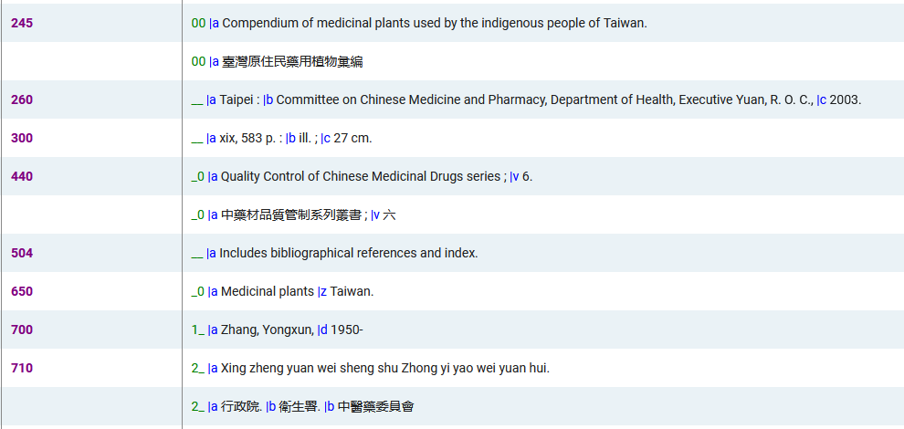
An invisible 880 exists in the record

Slide 10
An invisible 880 exists in the record
On the next slide, which shows the bibliographic record in the metadata editor
  We do see the 245, 440 and 710 in the original and in the Alternate Graphic Representation,
  We do not see the 880 field.

Slide 11
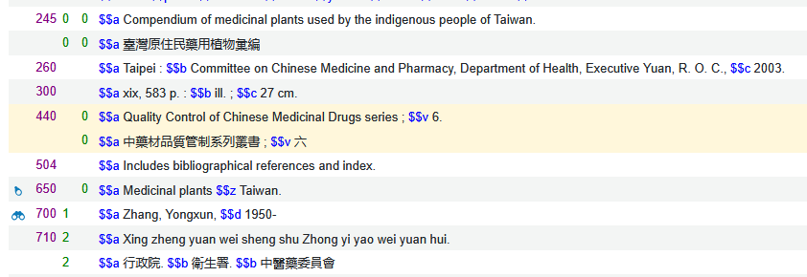
An invisible 880 exists in the record

Slide 12
An invisible 880 exists in the record
On the next slide, which shows the bibliographic record in the MARC XML,
  We do see the 245, 440 and 710 in the original and in the Alternate Graphic Representation,
  We do see the 880 field.
That means that the 880 is part of the MARC record even though previously we did not see it in the repository search results or in the metadata editor.

Slide 13
An invisible 880 exists in the record

Slide 14
An invisible 880 exists in the record
On the next slide, which shows the bibliographic record after doing "Display Source Record" from within Primo VE,
  We do see the 245, 440 and 710 in the original and in the Alternate Graphic Representation,
  We do see the 880 field.
That means that the 880 is part of the MARC record even though previously we did not see it in the repository search results or in the metadata editor.

Slide 15
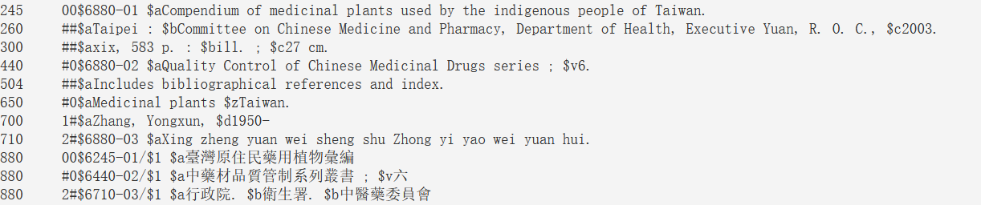
An invisible 880 exists in the record

Slide 16
An invisible 880 exists in the record
When the Alternate Graphic Representation displays in Alma it displays the contents of the field but not the field number "880"
Rather, it groups the Alternate Graphic Representations together in a clear and organized manner.
However, the 880 is really there, and stored in the database. During export to a MARC record and when displaying the source record from Primo VE it appears.

Slide 17
An invisible 880 exists in the record
The fact that the 880 field is part of the record (even though we do not see it) means that indication rules checking on the existence of an 880 field will state that the field is present.
Both of the following indication rules will be "true" on a record with an Alternate Graphic Representation
The rule on the left will be "true" if there is at least one Alternate Graphic Representation.
The rule on the right will be "true" if there are multiple Alternate Graphic Representation.
rule "Contains 880 field"
when
exists "880"
then
set indication."true"
end
rule "Contains multiple 880 fields"
when
existsMoreThanOnce "880"
then
set indication."true"
end

Slide 18
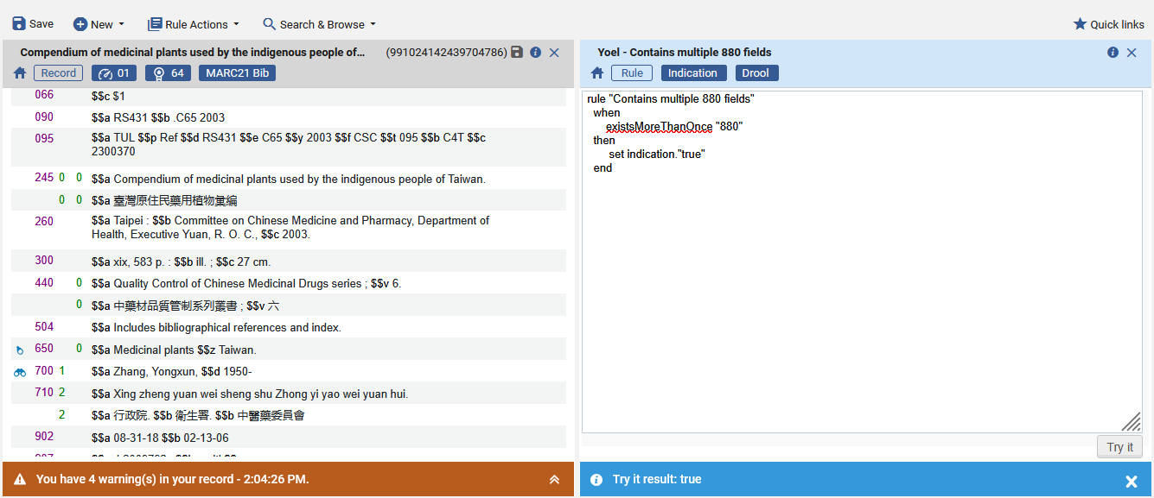
An invisible 880 exists in the record

Slide 19
Adding an 880 to a bibliographic record in the Metadata Editor

Slide 20
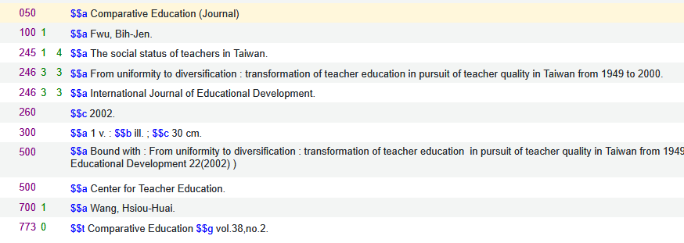
Adding an 880 to a bibliographic record in the Metadata Editor
We will now add an Alternate Graphic Representation to the record below for the following two fields
  1001_ $$a Fwu, Bih-Jen.
  500__ $$a Center for Teacher Education

Slide 21
Adding an 880 to a bibliographic record in the Metadata Editor
In both cases we will add the Alternate Graphic Representation in script CJK (Chinese, Japanese, Korean).
First, we will go through each step for the 100 field
  We will add this text: 符, 碧眞
Next, we will go through each step for the 500 field
  We will add this text: 敎務處敎育學程中心

Slide 22
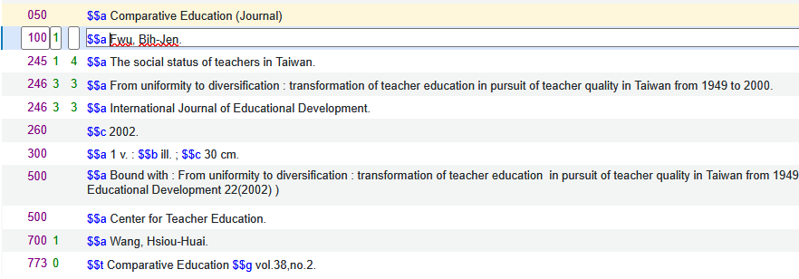
Adding an 880 to a bibliographic record in the Metadata Editor
Step 1: Put cursor on field 100
For the 100 field

Slide 23
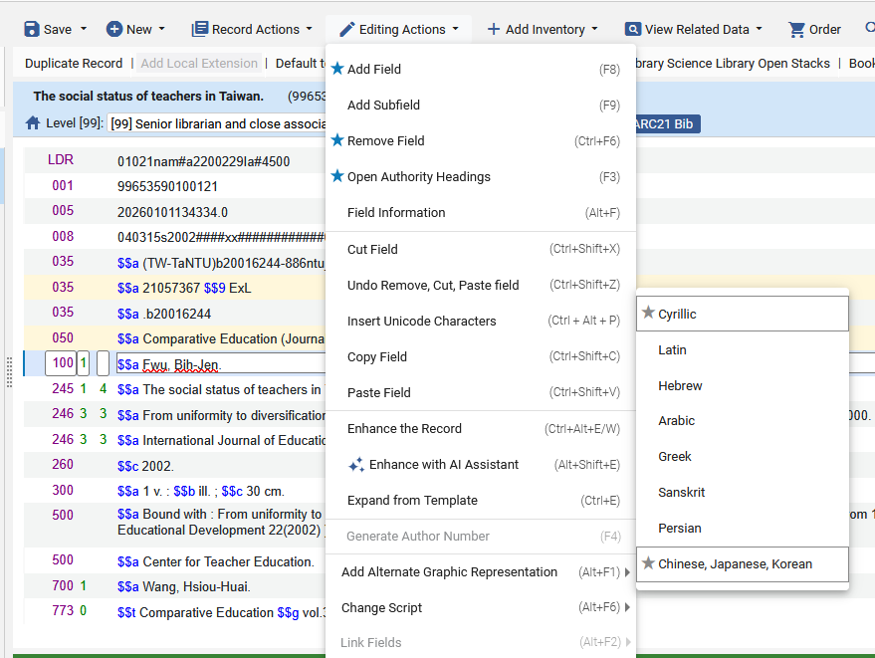
Adding an 880 to a bibliographic record in the Metadata Editor
Step 2: Choose menu "Editing Actions > Add Alternate Graphic Representation > Chinese, Japanese, Korean"
For the 100 field

Slide 24
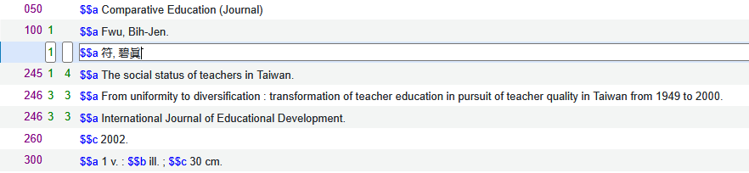
Adding an 880 to a bibliographic record in the Metadata Editor
Step 3: Add the field
For the 100 field

Slide 25
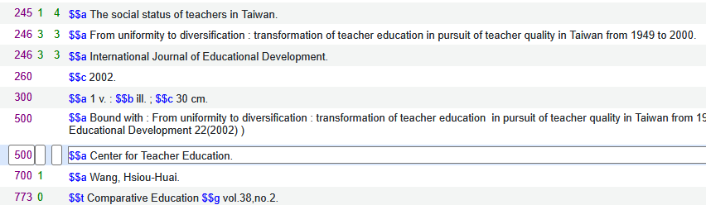
Adding an 880 to a bibliographic record in the Metadata Editor
Step 1: Put cursor on field 500
For the 500 field

Slide 26
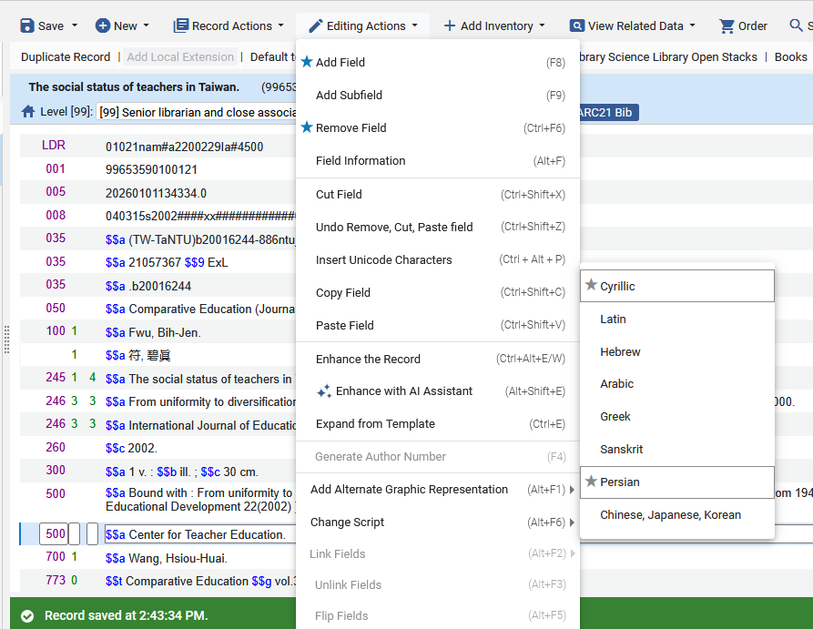
Adding an 880 to a bibliographic record in the Metadata Editor
Step 2: Choose menu "Editing Actions > Add Alternate Graphic Representation > Chinese, Japanese, Korean"
For the 500 field

Slide 27
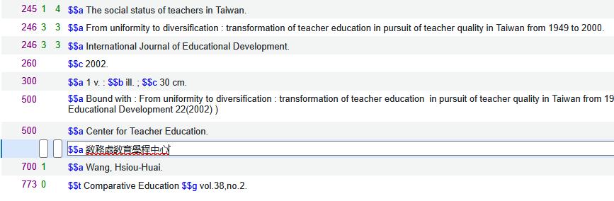
Adding an 880 to a bibliographic record in the Metadata Editor
Step 3: Add the field
For the 500 field

Slide 28
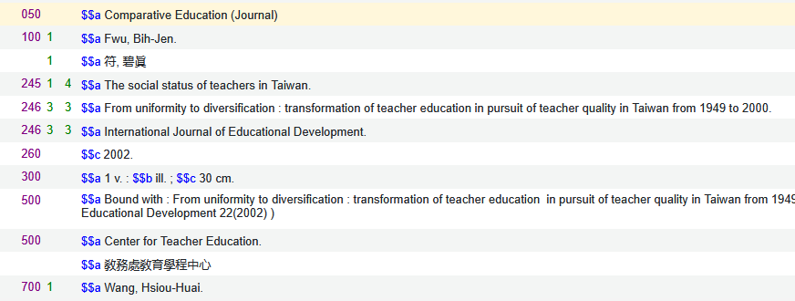
Adding an 880 to a bibliographic record in the Metadata Editor
The record has been saved in the Metadata Editor

Slide 29
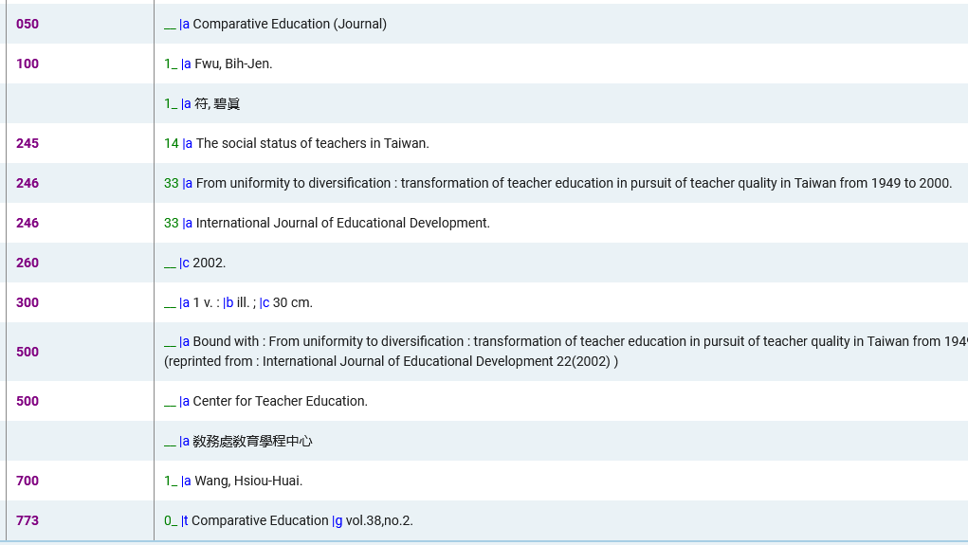
Adding an 880 to a bibliographic record in the Metadata Editor
Here is the record in the repository search

Slide 30
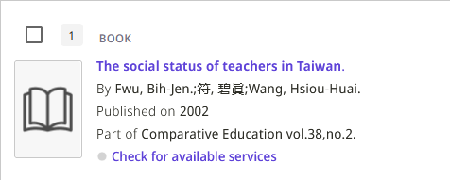
Adding an 880 to a bibliographic record in the Metadata Editor
Here is the record in Primo VE search results

Slide 31
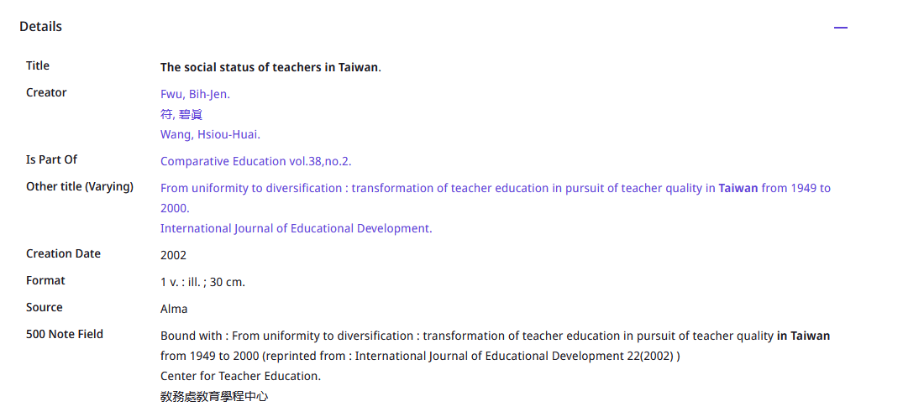
Adding an 880 to a bibliographic record in the Metadata Editor
Here is the record in Primo VE full display
Note that if and how the 880 fields display in Primo depends on the Primo display normalization rules.

Slide 32
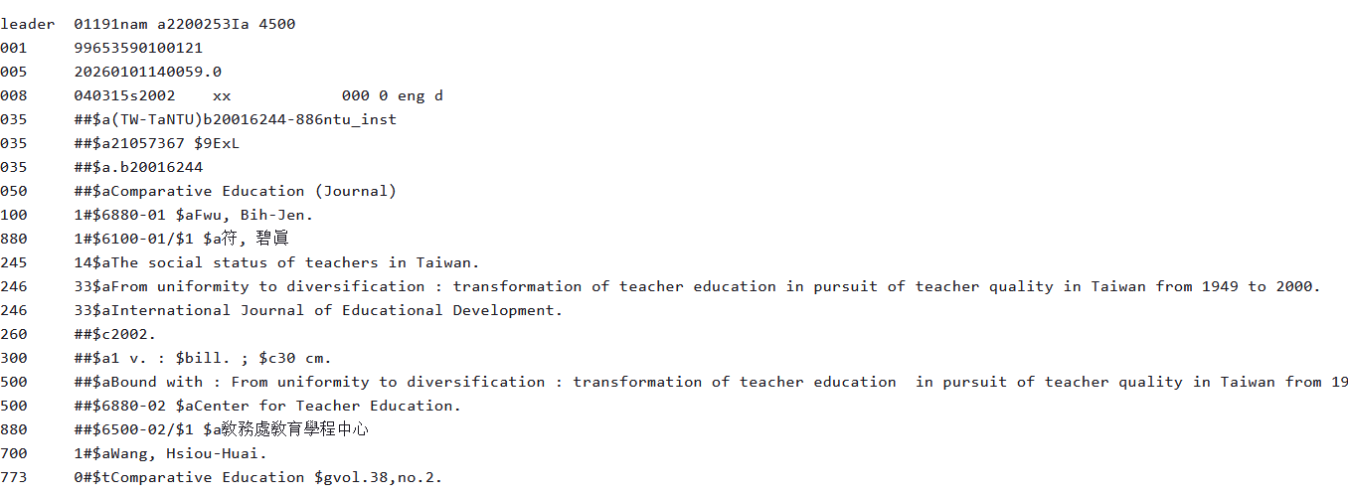
Adding an 880 to a bibliographic record in the Metadata Editor
Here is the record in Primo VE "display source record"

Slide 33
Adding an 880 to a bibliographic record during import

Slide 34
Adding an 880 to a bibliographic record during import
Earlier we showed that when a record in Alma which has an Alternate Graphic Representation is exported, the exported record has an 880 field for each Alternate Graphic Representation.
Therefore, if we import a record which has 880 fields (which are properly formatted) then the imported record in Alma will have the Alternate Graphic Representations.

Slide 35
Adding an 880 to a bibliographic record during import
Here is (part of) the MARC XML for title "The contribution of agriculture to the process of economic growth in Taiwan".
We see the 880 fields for the 100 and 245 fields.
<datafield tag="100" ind1="1" ind2=" ">
<subfield code="6">880-01</subfield>
<subfield code="a">Lee, Yung-Chung.</subfield>
</datafield>
<datafield tag="880" ind1="1" ind2=" ">
<subfield code="6">100-01/$1</subfield>
<subfield code="a">李, 永彰</subfield>
</datafield>
<datafield tag="245" ind1="1" ind2="4">
<subfield code="6">880-02</subfield>
<subfield code="a">The contribution of agriculture to the process of economic growth in Taiwan /</subfield>
<subfield code="c">Yung-Chang Lee.</subfield>
</datafield>
<datafield tag="880" ind1="1" ind2="4">
<subfield code="6">245-02/$1</subfield>
<subfield code="a">臺灣農業在經濟發展過程中的貢獻 /</subfield>
<subfield code="c">李永彰</subfield>
</datafield>

Slide 36
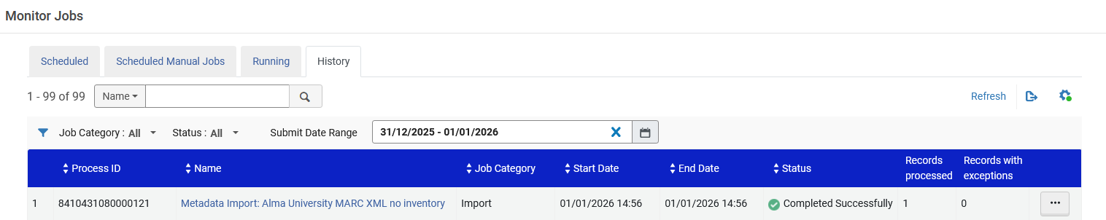
Adding an 880 to a bibliographic record during import
The bibliographic record is imported to Alma

Slide 37
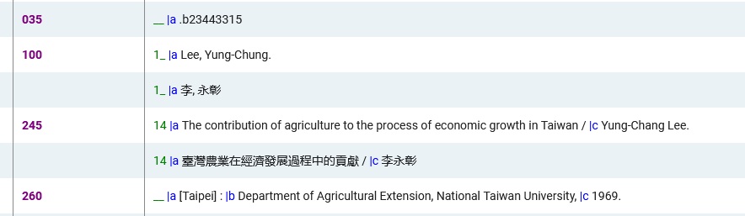
Adding an 880 to a bibliographic record during import
The Alternate Graphic Representations have been imported

Slide 38
Thank You

